Slide 1


Applying MCP Principles for Schema-Aware Data Interaction
MODEL CONTEXT PROTOCOL
By Nitish Raman

Slide 2




Backed by OpenAI, Microsoft, Google, Anthropic — designed to simplify scalable agent development.
Model Context Protocol = Way to plug Tools + Data + Prompts together for LLMs
WHAT IS MCP?
📂 Resources → What the model can access
🧰 Tools → What it can do
🧾 Prompt Wrappers → How it is guided, ensure context don't change
🧠 LLMs use MCP discover, plan & execute multi-step tasks
🔌The USB-C of AI agents.
-

Slide 3
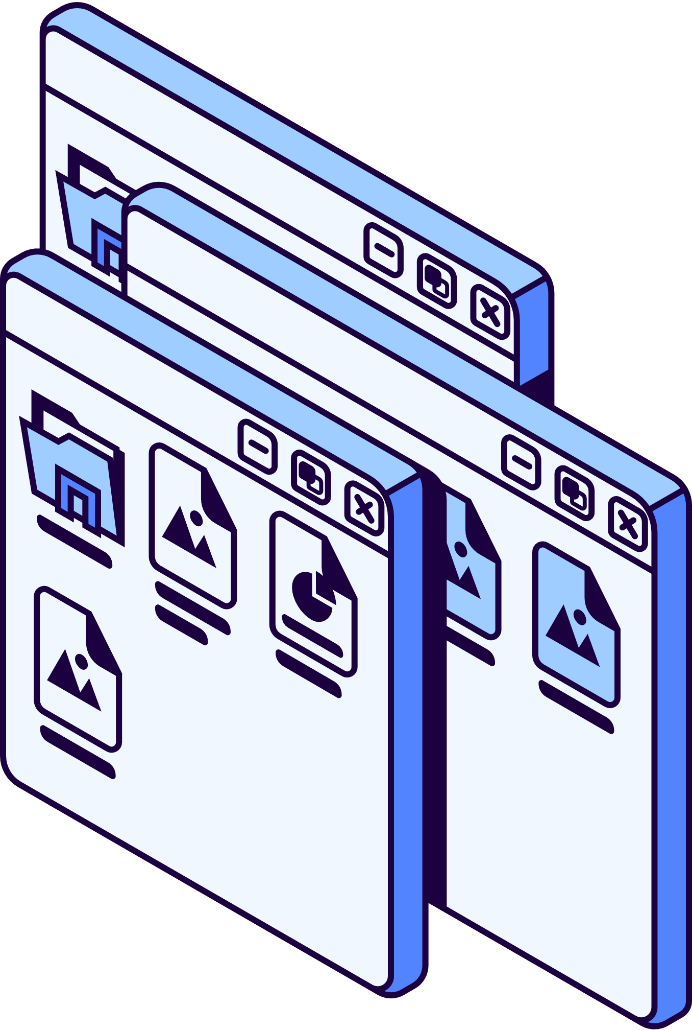
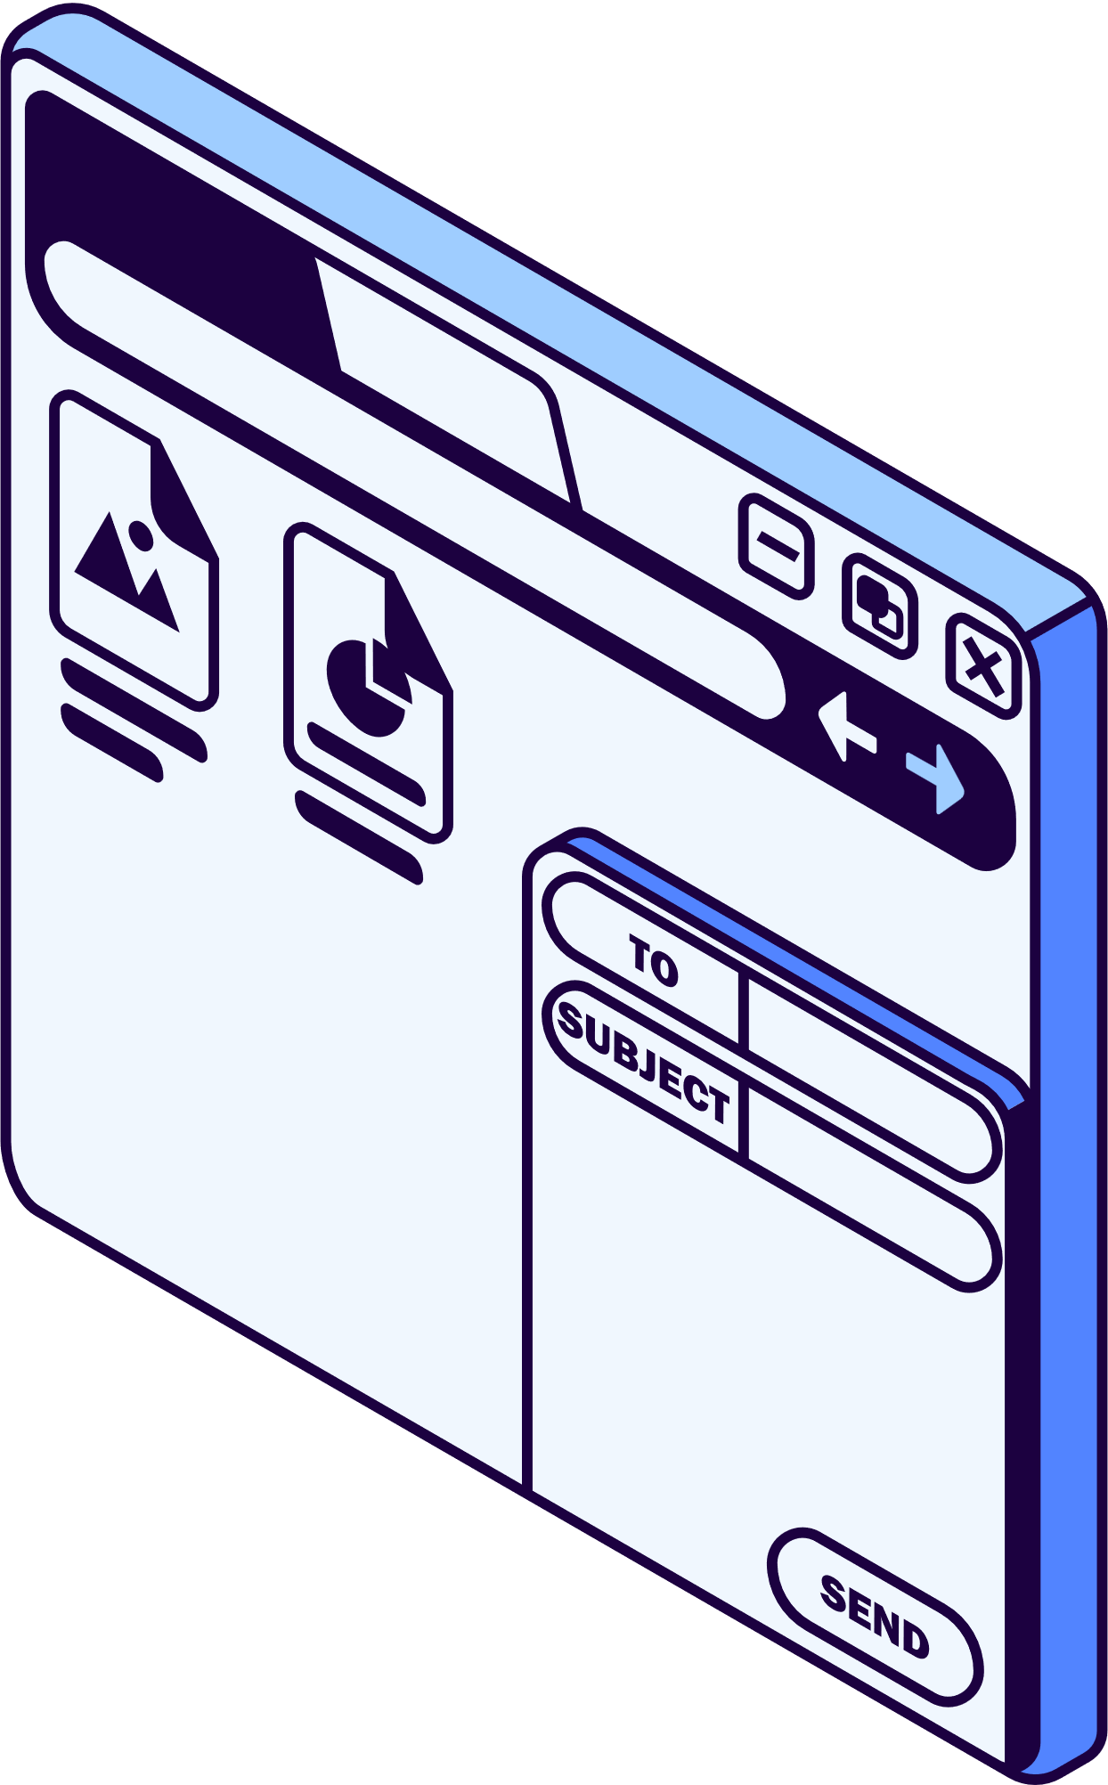
WHY
HOW
🧠 The LLM acts as brain, generating plans based on prompts, while MCP functions as the nervous system, connecting tools, managing memory, and executing actions dynamically.
🧩 Each layer — tools, wrappers, resources — is modular and swappable.
🔁 Agents stay consistent even when tools change.
🧠 The LLM plans, while MCP connects, discovers, and executes.
📈 AI usage is booming, but enterprise integration is still messy and manual.
🛠️ The old way relies on hardcoded prompts and toolchains, limiting flexibility.
✨ MCP introduce clean, modular standard for connecting LLMs to enterprise systems.
🚀 It enables safe, reusable, plug-and-play workflows at scale.
MCP WORKING
🌐 Similar to how HTTP standardizes communication between browsers & servers, MCP standardizes how LLMs interact with tools and data — becoming the backbone of intelligent LLM agents by standardizing how they access tools, data, & context.
🤔 If HTTP connects browsers to the web, MCP can connect LLMs to the world.

Slide 4
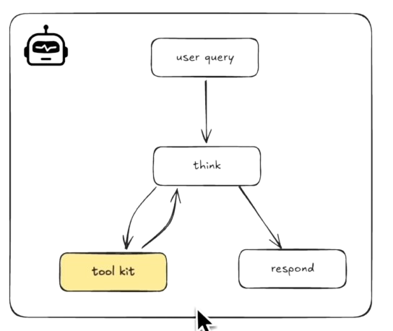
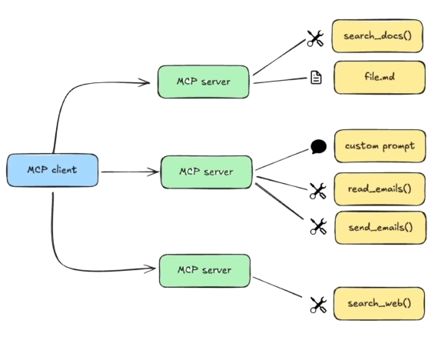

Slide 5
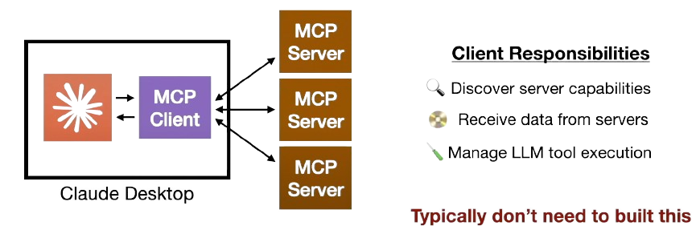
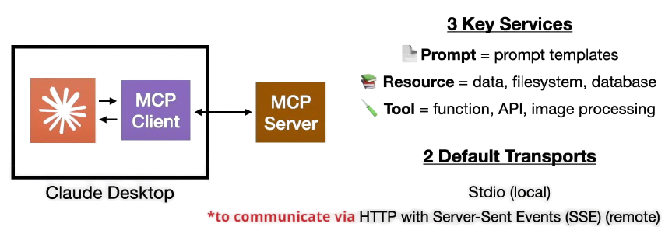

Slide 6
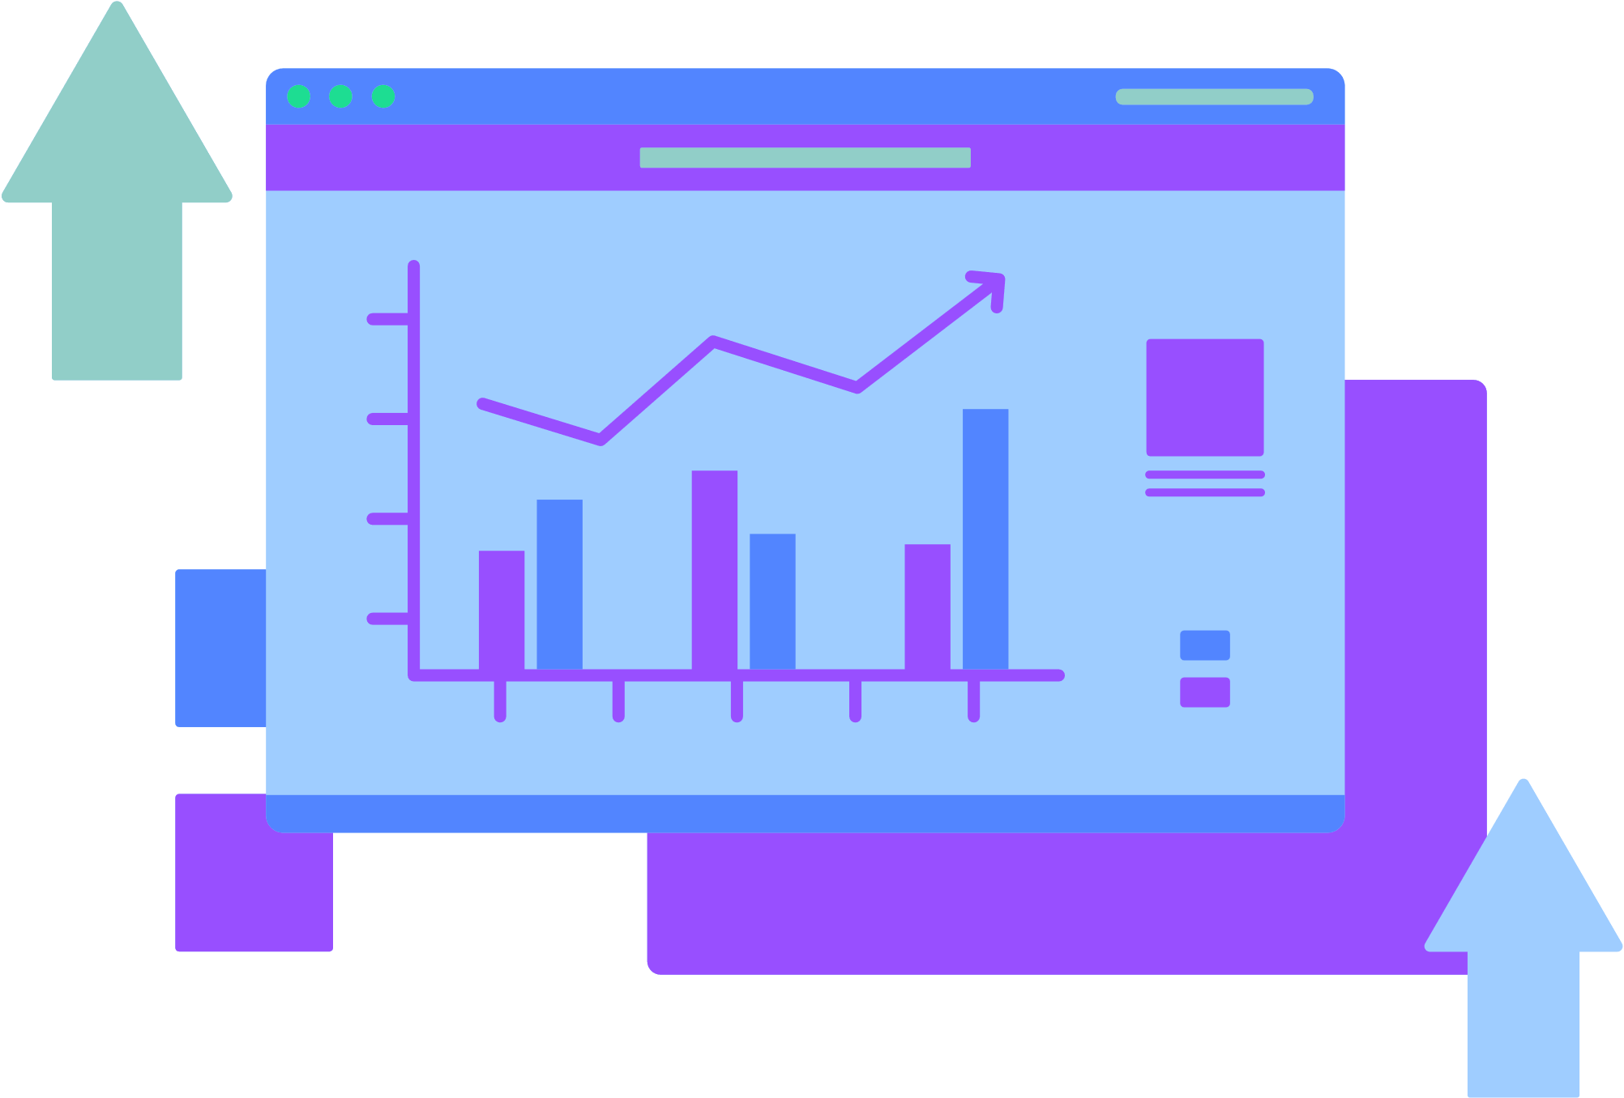
🧩 Interoperability — connect any tool or resource
🔁 Reusability — same agent, many tasks
⚙️ Less prompt engineering — wrappers do the work
📈 Scalable agent design — standard flows
🔐 Safer, auditable workflows — logs + control
BENEFITS OF MCP
Claude by Anthropic
Claude agents reason through tasks using tool-calling and self-planning logic.
This matches MCP’s goal of giving LLMs autonomy with structured context and tool access.
OpenAI GPTs (Function Calling)
ChatGPT uses structured function calls & context files to trigger tools like calculators, file readers, or APIs.
It reflects MCP by combining resources, tools, and wrappers in a standard, reusable way.
LangChain + LangGraph (Open Source)
ChLangChain lets developers register tools and memory for LLM workflows.
LangGraph orchestrates tool sequences. Together, they model MCP’s modular, discoverable pipeline.

Slide 7
CHALLENGES
LLMs are great at text — but struggle with structured files (CSV, DB, XML)
Analysts still rely on manual SQL, Excel transformations
Goal: Can we help LLMs understand & use real-world datasets?
AI is powerful—but it needs context + tools to be useful.

Slide 8
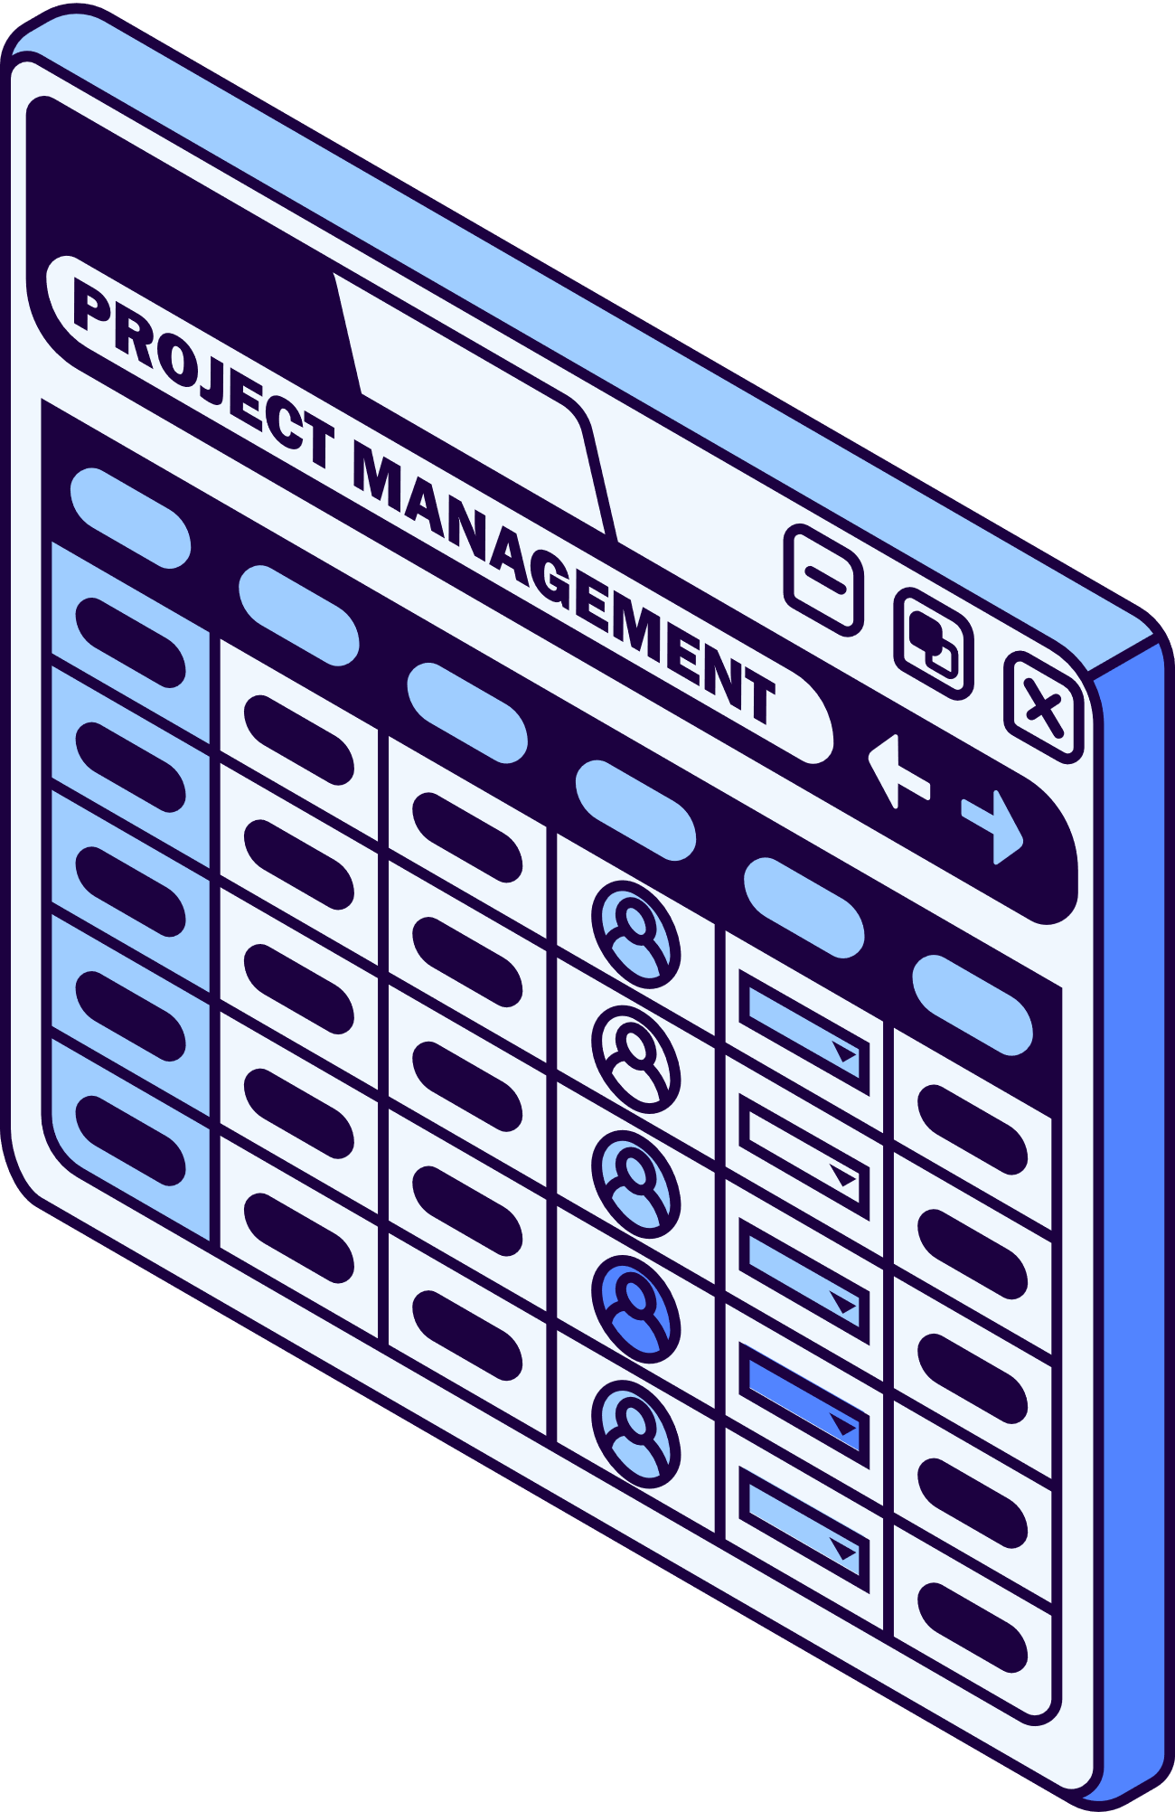


PROJECT
Key Feature
Tech Stack
Folder Overview
📂 Upload dataset (CSV, Excel, JSON, ZIP, DB).
🧠 LLM-powered column summary & key/tag inference.
💬 Prompt to SQL with chat history.
📊 Chart builder for visualisation.
🛢️ Optional Supabase export.
project_root/
├─ app/
├─ pages/
├─ mcp_server/
├─ sample_datasets/
├─ home.py
├─ run.bat
└─ README.md
└─ requirements.txt
🖥️ UI built using Streamlit.
⚙️ Backend powered by FastAPI.
🧬 Vector search via ChromaDB with SentenceTransformers.
🤖 LLM integration with Ollama, OpenAI, or GPT4All.
💽 Data storage handled through SQLite.
# Python logic modules
# Streamlit interface tabs
# Output
# Example Input
# Launch script

Slide 9
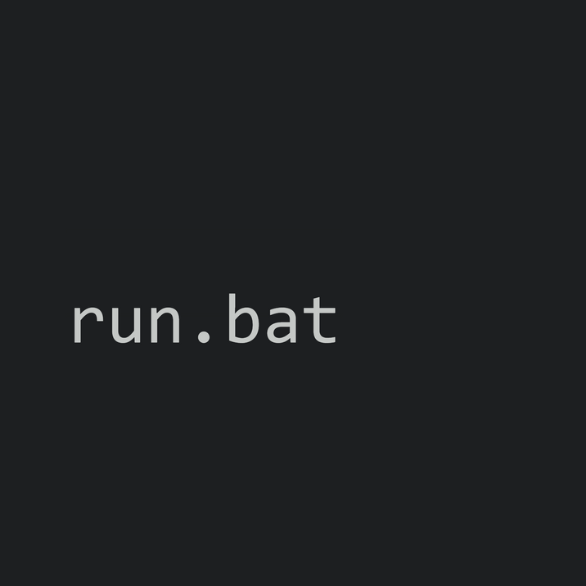
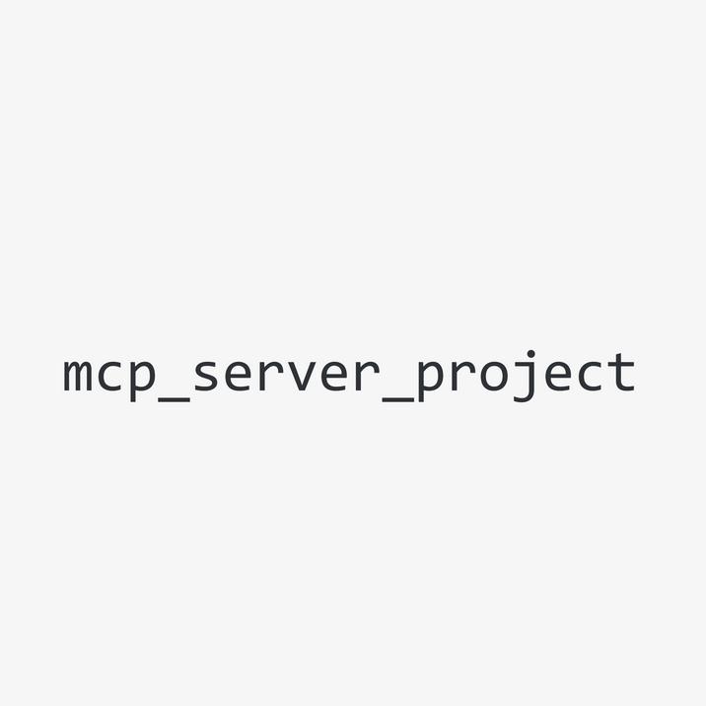
▶️To launch the MCP Server, run the run.bat file located in the root folder(mcp_server_projec)
STREAMLIT PIPELINE
1 Upload & Preview: Select & preview dataset (CSV, Excel, JSON, ZIP, DB)
2 Describe Schema: Generate LLM-powered schema summary, PK/FK tags
3 Prompt → SQL: Convert natural prompt into SQL and view result
4 Chart Generator: Select chart type and render using schema columns
5 Supabase: Pull Supabase/PostgreSQL for analysis
6 Interactive Chat: Ongoing chat with schema memory
Output
📦 dataset.db (SQLite database)
📊 CSV/Excel preview and ingest
🧾 schema_description.txt
🗂️ metadata.json with tags, primary keys, foreign keys
🧠 Chroma vector index
📝 query_log.txt & chat_log.txt
📈 Optional ER diagram image
📥 Upload → 📄 Parse File → 🧠 LLM Describe → 🧬 Vectorize → 💬 ChatSQL → 📊 Visualize

Slide 10
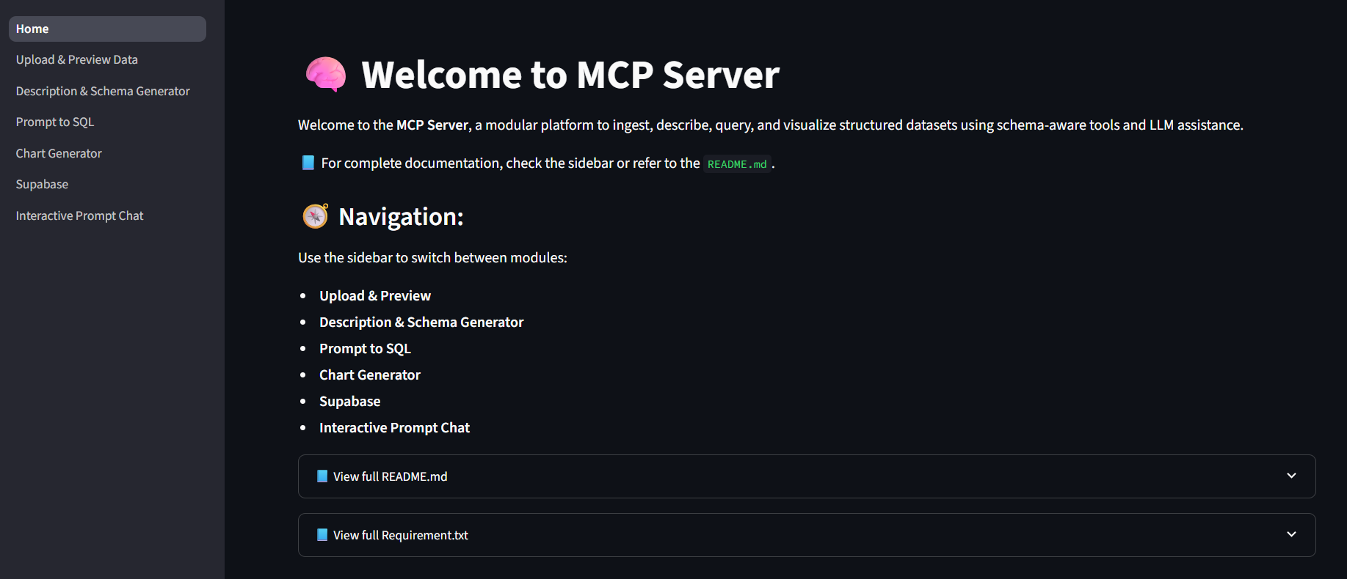
Navigate to Different Mcp Server
Click for Readme Text
Click to see Requirement

Slide 11
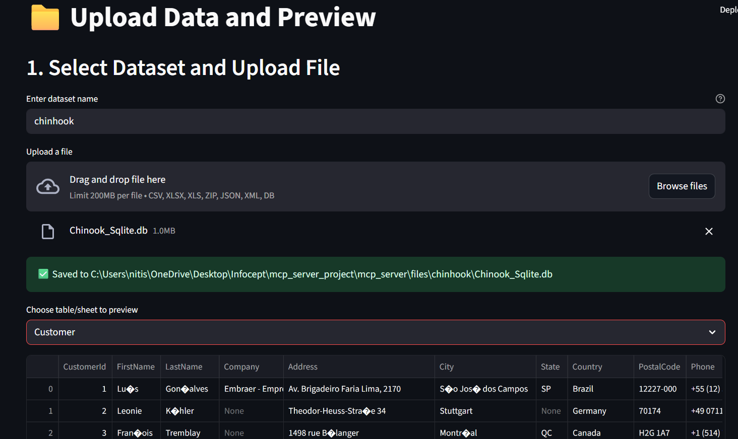
Give Dataset Name
Browse & Upload File
Output Path
Click to Select Table

Slide 12
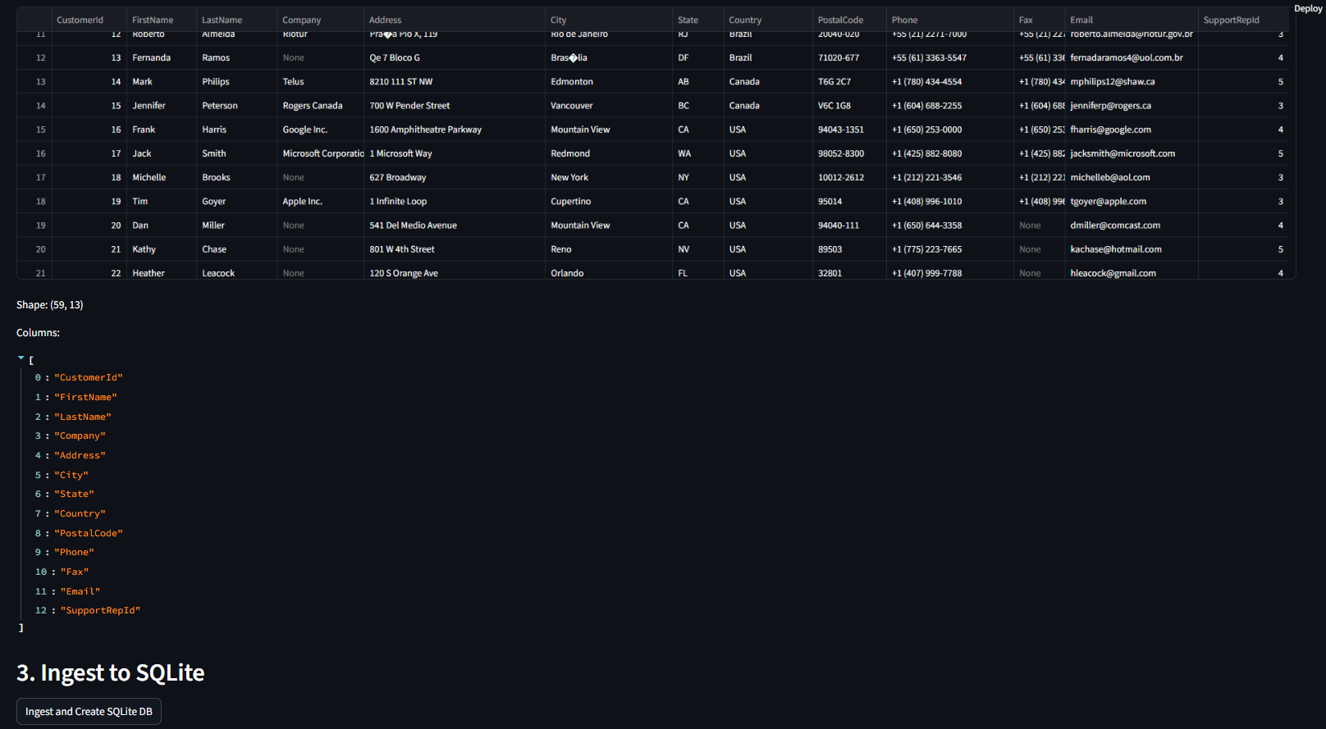
Table Preview
Column List
Click to Save as db File

Slide 13
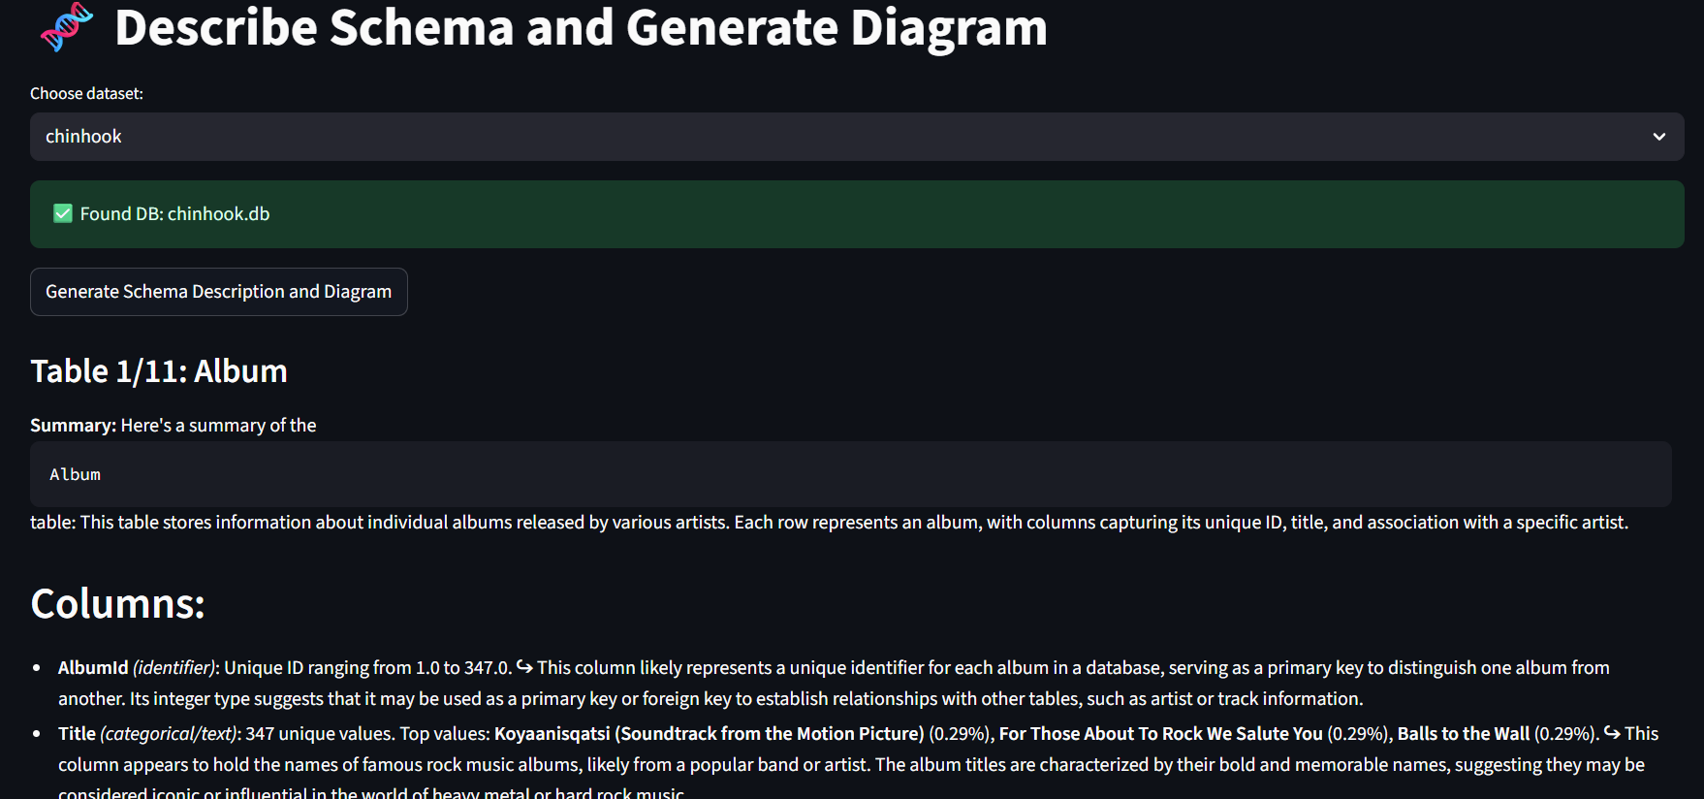
Click to Select Dataset
Click to generate Schema & Vectorize
LLM Powered Description of Tables & Columns

Slide 14
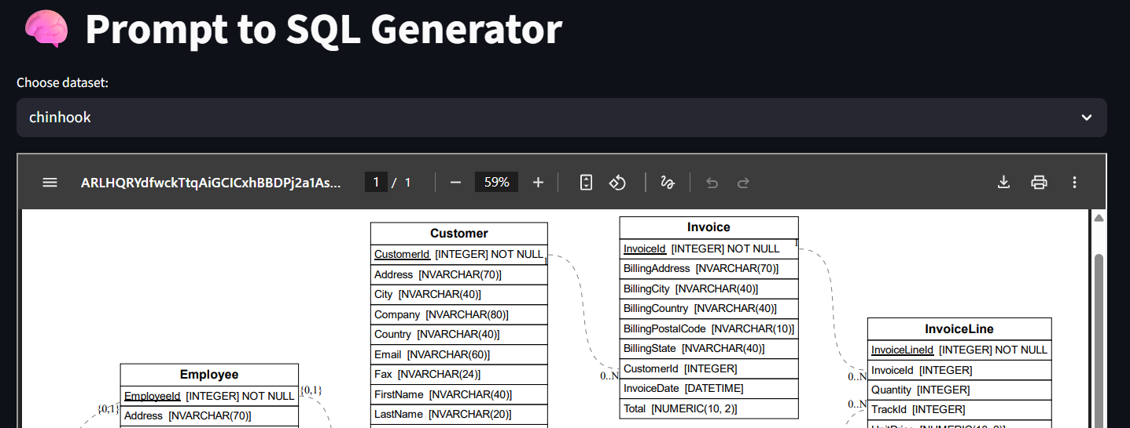
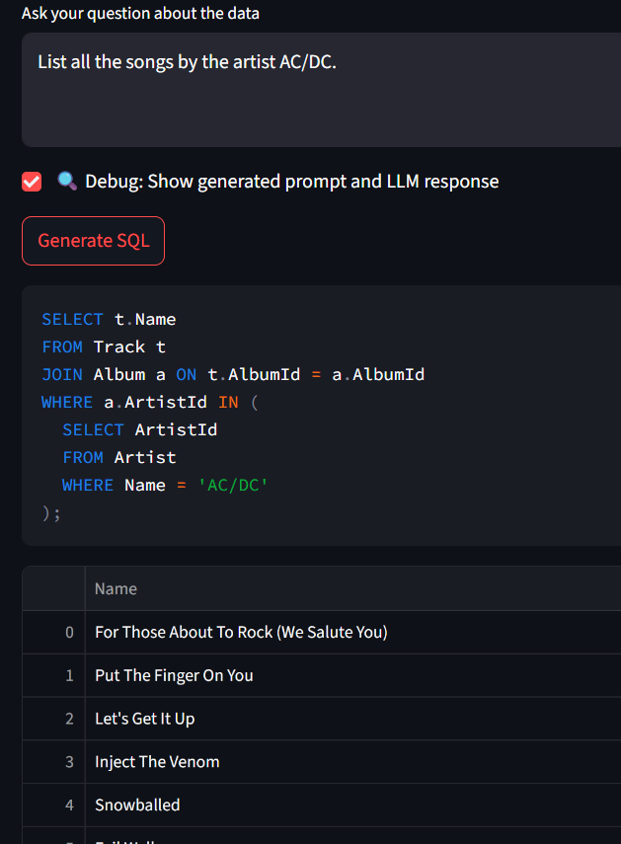
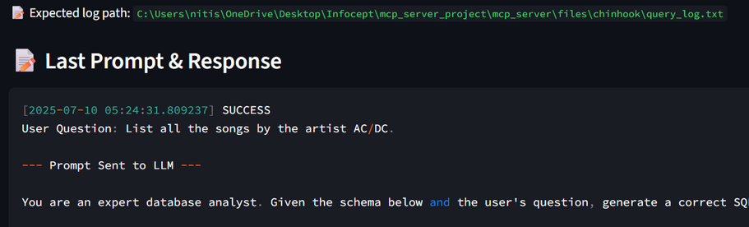
click to select dataset
Natural Language Prompt by User
Click to generate SQL
Generated SQL
ER Diagram to understand structure
Prompt Sent
Result

Slide 15
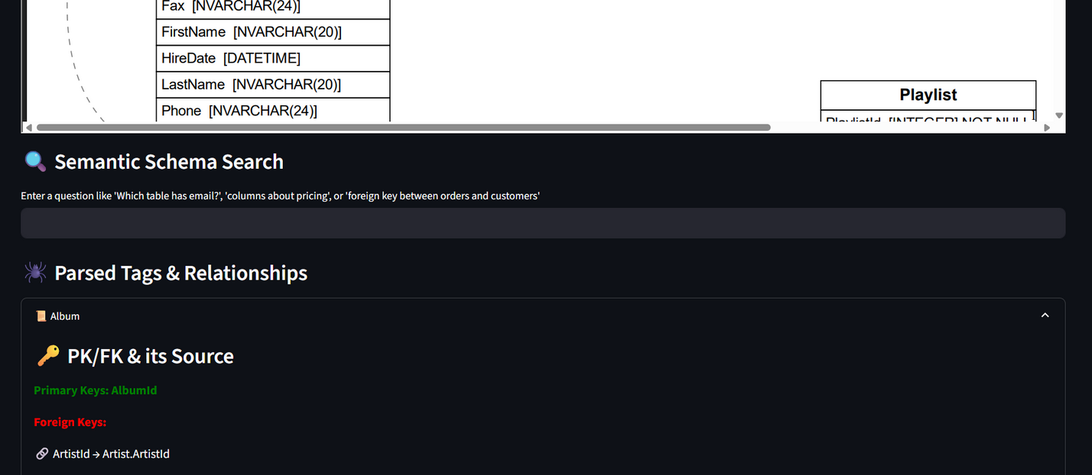
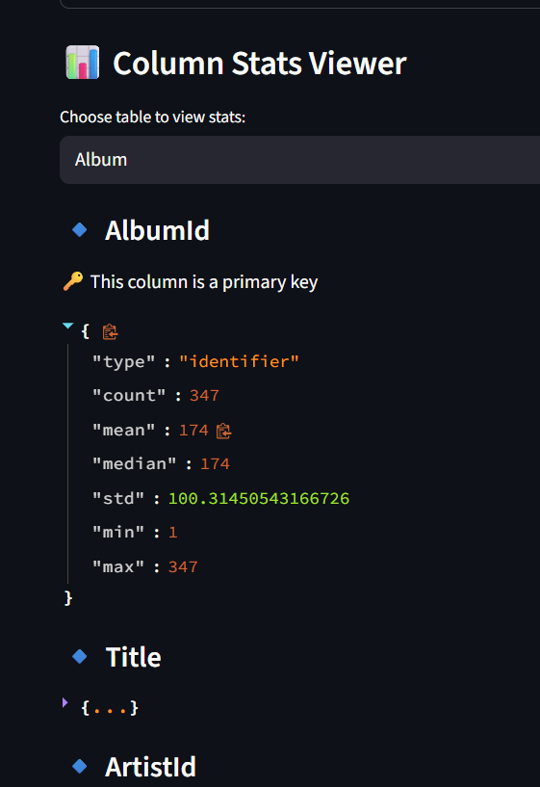
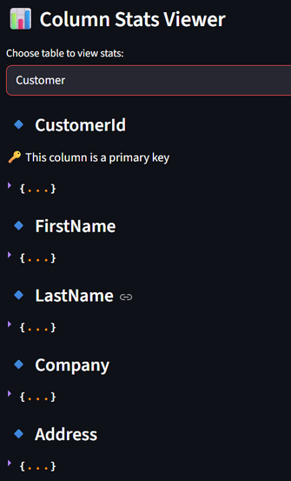
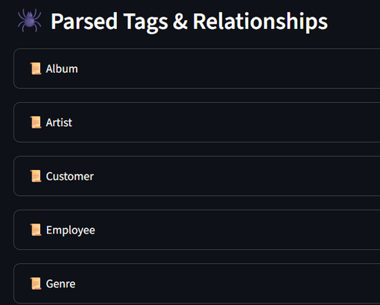
ER Diagram using LLM
Semantic Search for Vector Db
Tags & Relationship for each table using LLM
Click to Select Table
Browse to see Column Statistics

Slide 16
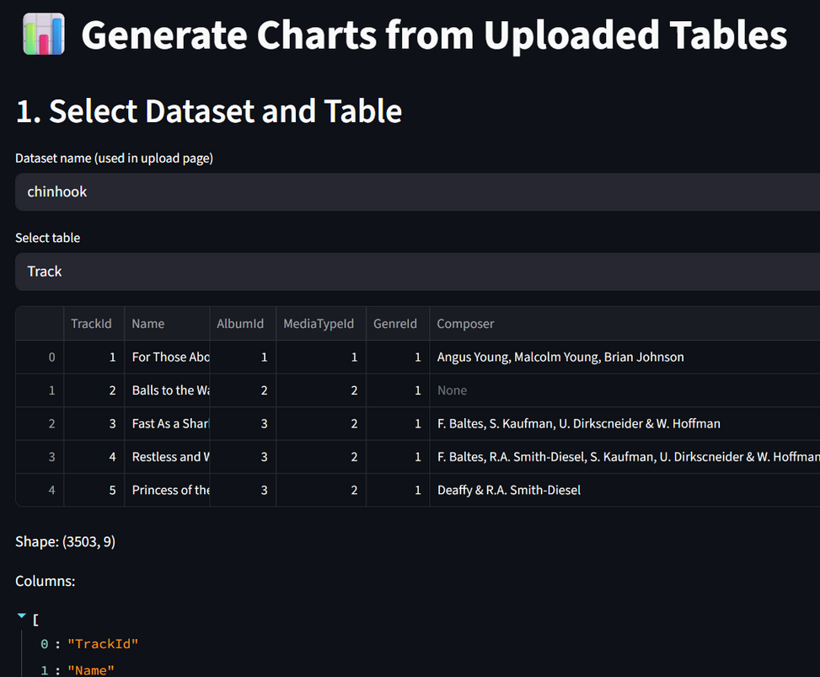
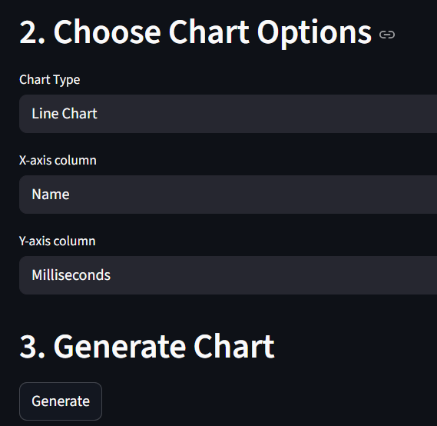
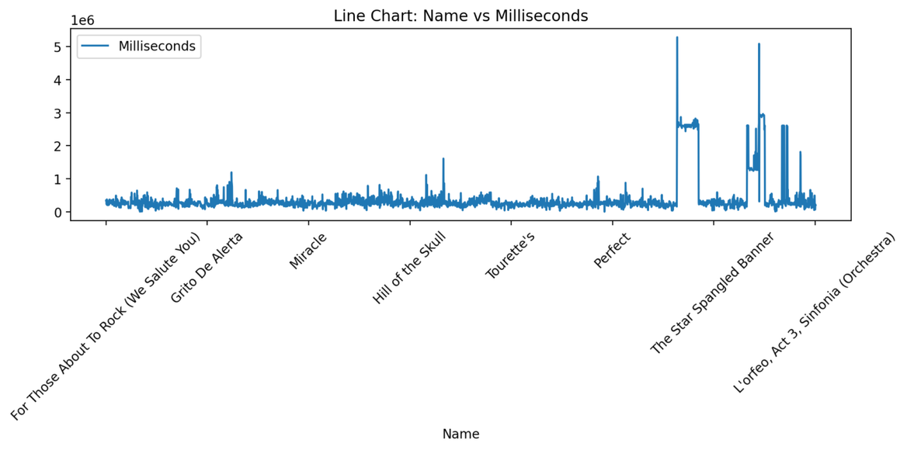
Click to Select Dataset
Click to select Chart Type
Click to select X-axis Column
Click to select Y-axis Column
Table preview & Columns Detail
Click to generate Chart
Sample Chart

Slide 17
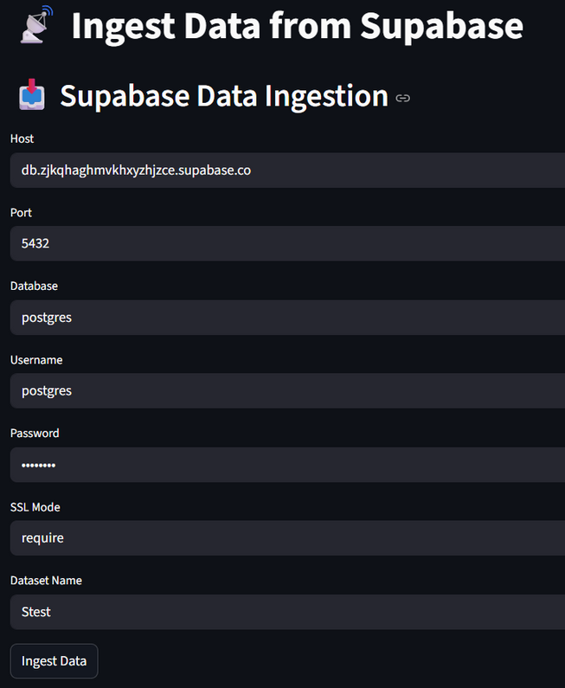
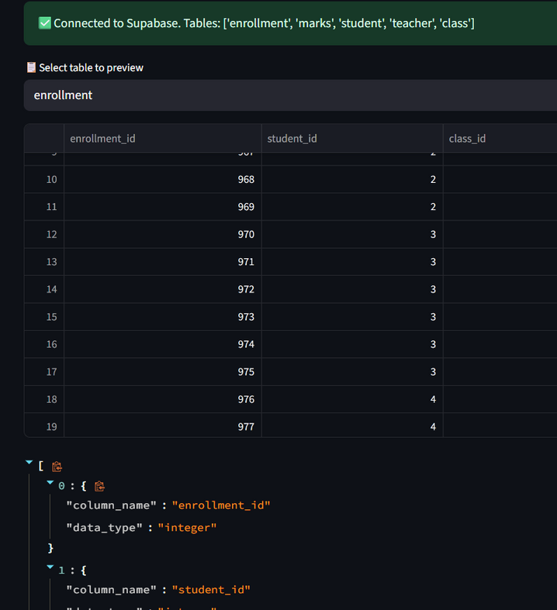
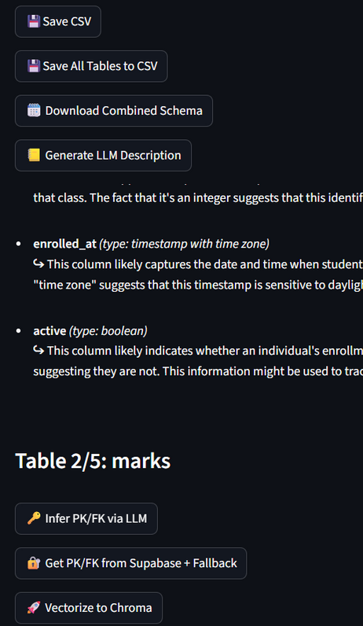
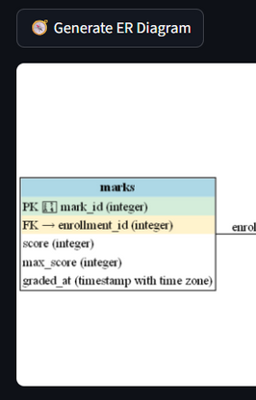
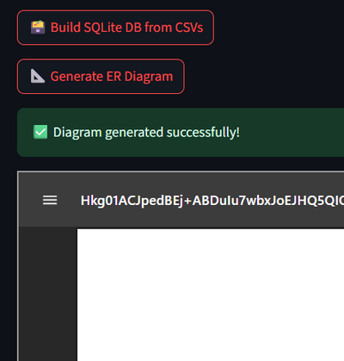
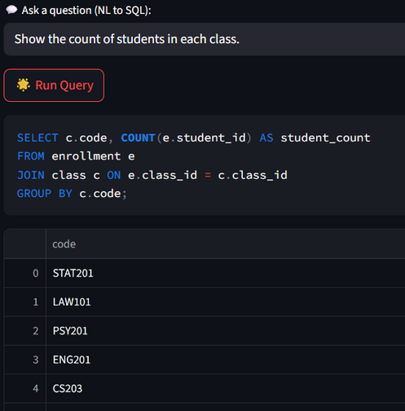
Click to Save Table as CSV
Click to Select Table
Click to Save all Tables as CSV
Click to create Schema
Click to generate description
Table Preview
Fill Supabase Server Details
Description
Browse to see column details
Click to infer PK/FK with LLM(when no PK/FK detail present)
Get Final PK/FK either from Supabase or else use Inferred
Click to Ingest data
Click to vectorize db
Click to generate diagram using supabase
Click to save db file
Click to vectorize db
Diagram
Click to generate diagram using ERalchemy
SQL Query
Diagram
Result

Slide 18
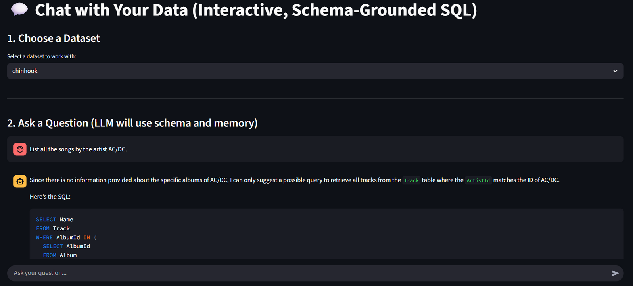
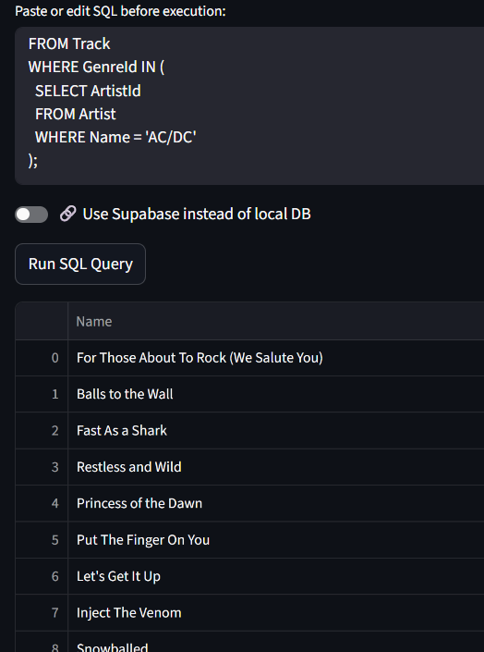
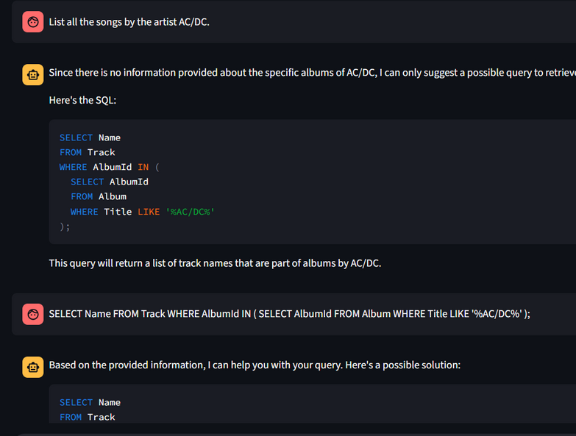
Click to select database
Paste Final SQL Query
Give prompt
Select where to run SQL query db or Supabase
Click to Run query
Interactive Chat
Result

Slide 19
🚀 What This Project Demonstrates
🌱 Future Enhancements
🧠 LLMs + Schema Context → Smarter Structured Data Interaction
🧩 Modular Architecture → Plug-&-play MCP-aligned tools
📊 Prompt-to-SQL → Empower analysts with minimal coding
🔌 Open Backends → ChromaDB + Ollama for flexibility
🧠 Error-aware SQL correction & explanations
📁 Add support for Parquet, Avro, remote APIs
🔄 Live database sync & streaming query support
🔐 User roles and access control features
📈 Auto-chart recommendations from prompt or data type
🔗 Integration with BI tools (Power BI, Tableau)

Slide 20
Team:
Sudharsanam R
Sanket Ninawe
Nitish Raman
Important Links
GitHub
Github
Supabase Server
Host db.zjkqhaghmvkhxyzhjzce.supabase.co
Port 5432
Database postgres
Password p@55w0rd
SSL Mode require
MCP Documentation
MCP Point of View
MCP Server Documentation

Slide 21
Q&A
Thank You

